Slide 1
Digital Portfolio
STUDENT NAME :
AKASH. s
RIGISTER NO AND NMID :
24131041802521003 & asanm10424cs10
COLLEGE / UNIVERSITY :
JAWAHAR SCIENCE COLLEGE
STUDENT NAME : MOHAN RAJ .A
REGISTER NO AND NMID :
DEPARTMENT: B.s.c.Computer science
COLLEGE: COLLEGE/ UNIVERSITY: Annamalai University

Slide 2
Simple c0llege admission
Project Name

Slide 3
PROBLAM STSTEMENT:
In the digital age, websites and web applications are essential for communication, business, education, and entertainment. However, creating an interactive, visually appealing, and user-friendly website requires a strong foundation in HTML, CSS, and JavaScript.HTML (HyperText Markup Language) is used to structure the content of a webpage, such as text, images, tables, and forms.CSS (Cascading Style Sheets) provides styling and design features like colors, layouts, responsiveness, and animations to enhance user experience.JavaScript adds interactivity and dynamic functionality, such as form validation, animations, real-time updates, and event handling

Slide 4

AGENDA
Problem Statement
Project Overview
End Users
Tools and Technologies
Portfolio design and Layout
Features and Functionality
Results and Screenshots
Conclusion
Github Link
3/21/2024 Annual Review

Slide 5

PROJECT OVERVIEW:
The project focuses on developing a responsive and interactive web application using the three core web technologies: HTML, CSS, and JavaScript.HTML is used to create the structural framework of the webpage, including headings, paragraphs, images, forms, tables, and navigation elements.CSS enhances the presentation by applying styles such as colors, typography, layouts, transitions, and responsive designs to ensure the website is visually appealing and user-friendly on all devices.JavaScript adds interactivity and dynamic behavior, such as form validation, event handling, animations, data manipulation, and real-time updates, making the website engaging and functional

Slide 6
WHO ARE THE END USERS?
The end users of this project are the people who will directly use or interact with the web application developed using HTML, CSS, and JavaScript. They may include:
Students and Learners – Individuals learning web development who want to understand how structure, style, and interactivity work together.
Teachers and Trainers – Educators who can use the project as a teaching tool or demonstration for explaining web technologies.
General Website Visitors – Users accessing the website for information, entertainment, or services depending on the project type (e.g., portfolio, to-do app, or tabulation system).
Clients and Employers – People evaluating the developer’s skills, such as potential recruiters, hiring managers, or customers who want to assess the quality of web development work.
Developers and Designers – Fellow developers who can reuse, adapt, or improve the project for their own applications

Slide 7

TOOLS AND TECHNIQUES:
Tools:
Techniques:

Slide 8
Tools Used:
Text Editor / IDE – To write and manage code. Examples:Visual Studio Code (VS Code)Sublime TextNotepad++
Web Browsers – For testing and running the project. Examples:Google ChromeMozilla FirefoxMicrosoft Edge
Developer Tools (Browser DevTools) – For debugging, inspecting elements, testing responsiveness, and optimizing performance.
Version Control System – (Optional) For project management and collaboration. Example: Git & GitHub.
Design Tools – (Optional) To design layouts and UI. Examples: Figma, Canva, or Adobe XD.

Slide 9
Techniques Used:
HTML (Structure)Semantic elements for clear content organization.Forms, tables, multimedia embedding.Accessibility considerations (alt text, labels).
CSS (Styling & Layout)Responsive design using Flexbox and Grid.External and internal style sheets for modularity.Transitions, hover effects, and animations for better UI.
JavaScript (Interactivity & Logic)Event handling (onclick, onsubmit, etc.).Form validation and dynamic content updates.DOM manipulation for interactive behavior.Use of functions, loops, and conditional statements for logic building.
Responsive & Cross-Browser TechniquesMedia queries for different screen sizes.Testing on multiple browsers/devices for compatibility

Slide 10
POTFOLIO DESIGN AND LAYOUT
A portfolio website is designed to showcase personal details, skills, projects, and achievements in a structured and visually appealing way. The layout is divided into different sections to provide clarity and easy navigation for the end users.
● Design ApproachClean and Minimalistic UI – Focus on simplicity with modern typography and color schemes.Responsive Layout – Adjusts automatically for desktops, tablets, and mobile devices.Interactive Elements – Hover effects, animations, and transitions to enhance user experience.Consistent Styling – Uniform color palette, icons, and spacing for a professional look.

Slide 11
●Layout
1.Header / Navigation BarLogo or name at the top.Navigation links: Home, About, Skills, Projects, Contact.Responsive hamburger menu for mobile devices.
2. Home / Introduction SectionProfile picture or banner.Short introduction and tagline.Call-to-action button (e.g., “Hire Me” or “View Resume”).
3. About SectionPersonal background.Career objectives.Key highlights (education, experience).
4. Skills SectionList of technical and soft skills.Progress bars or icons for representation.
5. Projects / Portfolio SectionGrid or card-based layout for projects.Each project includes image, description, and link (demo or GitHub).
6. Achievements / Certifications (Optional)Showcase awards, certificates, or recognitions.
7. Contact SectionContact form (with JavaScript validation).Email and phone details.Social media icons (LinkedIn, GitHub, etc.).
8. Footer

Slide 12
FEATURES AND FUNCTIONALITY
Responsive Design – The portfolio adapts to all devices (desktop, tablet, mobile) using CSS Flexbox/Grid and media queries.
Navigation Bar – A fixed and responsive navbar with smooth scrolling to different sections.
Interactive Home Section – Includes profile image, introduction, and call-to-action buttons (e.g., Download Resume, Hire Me).
About Section – Displays personal details, career objectives, and background information.
Skills Showcase – Visual representation of technical and soft skills using progress bars, icons, or charts

Slide 13
Functionality:
Navigation FunctionalityClick on navbar links to scroll to respective sections.Responsive hamburger menu for small screens.Form FunctionalityJavaScript validates the contact form (e.g., valid email format, required fields).Prevents empty or incorrect submissions.Project CardsHover effect reveals project details.Clickable links redirect to live demos or GitHub repositories.Dynamic InteractivityJavaScript adds animations (e.g., typing effect, fade-in sections).Skills section can animate progress bars when scrolled into view.Responsive LayoutPortfolio adjusts seamlessly across devices for better accessibility and user experience

Slide 14
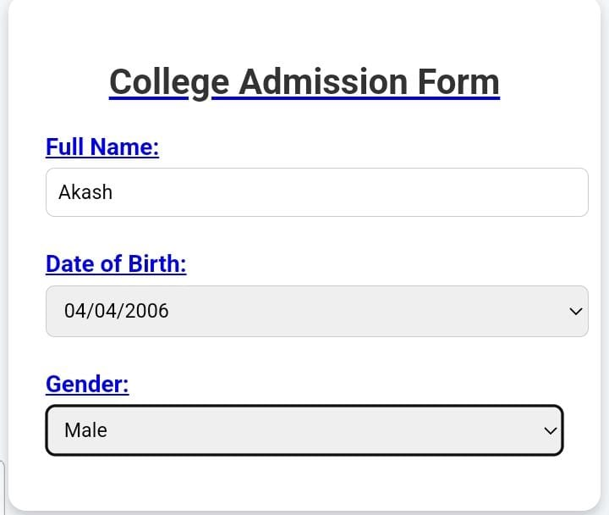

RESULTS AND SCREENSHOTS
3/21/2024 Annual Review
14

Slide 15
CONCLUSION :
The project demonstrates the effective use of HTML, CSS, and JavaScript to design and develop a fully functional and visually appealing web application. By combining HTML for structure, CSS for styling and layout, and JavaScript for interactivity, the portfolio website provides an engaging platform to showcase skills, projects, and personal details in a professional manner.The project highlights the importance of responsive design, ensuring accessibility across multiple devices, and the role of interactivity in enhancing user experience. Additionally, features like navigation menus, contact forms, and project showcases make the portfolio not only informative but also user-friendly.Overall, this project proves that mastering these three core web technologies enables developers to create modern, responsive, and interactive websites. It serves as a strong foundation for future advancements in web development and can be further enhanced by integrating backend technologies or frameworks
15

